Slide 1
CSCI1300
Object-Oriented Programming in Python

Slide 2


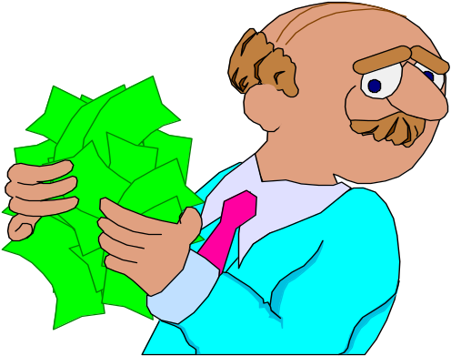
Objectives
Meet the professor
Understand the requirements of the course
Have fun!!

Slide 3

JUDY ETCHISON
Other times
by appt.
Tues./Thurs.
12-12:30
Ritter 115
Wed./Thurs.
9:15-10am
Ritter 117
jsetchison@earthlink.net
Course url/powerpoints
http://cs.slu.edu/~etchisonjs/csci1300/Week1.ppt

Slide 4
Method of Evaluation
Tests 60%
Programs 15%
Homework 5%
In-class quizzes 20%

Slide 5

Homework Assignments (HWK)
Due Monday at the beginning of class
Can be handwritten
Student’s responsibility to have work turned in on-time or early in the case of an excused absence
Late assignments are NOT accepted
Lowest two homework grades can be dropped

Slide 6
Submitting Programming Projects (PPx.py)
Due date announced in advanced; usually due by midnight on Friday
Student’s responsibility
to have work turned in
on-time or early.
Late assignments can be turned in up to 48 hours late but will loose 30 points
Students are encouraged to begin work on programs as soon as the material is discussed in class lecture

Slide 7

Submitting Programming Projects
Because the due date for programming projects is announced well in advanced….
Late assignments will not be accepted once the Blackboard late folder closes

Slide 8
Submitting Programming Projects
Uploaded to Blackboard
    All Source code files (.py)
    Any required design documents

Slide 9
Lab Assignments (In-class quizzes)
Due Thursday in class
Student’s responsibility to have work turned in on-time or early in the case of an excused absence
Late assignments are NOT accepted
Lowest lab grade will be dropped

Slide 10

EXAMS
EXAM 1
Administered in class
Exams are open book
No make-up exams unless a valid/ documented excuse has been submitted to your professor BEFORE the exam date
In the event of a university sanctioned event, exam may be taken early

Slide 11
Attendance Policy
Students are expected to attend all class lectures and lab sessions. Your grade will be a reflection of the time you spend inside and outside of class.

Slide 12
Academic Ethics
You are expected to create, edit and print out YOUR OWN assignments and take tests without outside assistance. All work is expected to be your own.

Slide 13
Academic Ethics
You should never look at or review another person’s work for any given assignment; that includes looking at papers or even at the computer screen where student work is displayed.
You should never give an answer to or receive an answer for an assignment, or any parts of any assignment, from another person; again, that includes source code, design documents, homework, etc.

Slide 14
Academic Ethics
If you collaborate with another person for a graded assignment as in the example activities noted above, all parties involved will receive a zero for that assignment. If there are further assignments for which you have collaborated, all students involved will receive an F in the class and a report will be filed with the Department and/or the Dean for further action. All further correspondence will be done through their offices.

Slide 15
Academic Ethics
THEREFORE, it is imperative if you need help on your assignments that you contact your instructor or department tutor and NOT someone else.

Slide 16
See the following links on Blackboard
Course Syllabus and Outline
Programming guidelines
Installing Python

Slide 17
Week 1 Assignments
(see course outline also)
Make sure that you can log into Blackboard and the Hopper server. Any problems with Blackboard, contact your instructor.
Be sure to always bring your textbook to class.
You will be completing Lab1 Assignment on Thursday and should read/do the PreLab1 assignment listed on your outline

Slide 19
Week1 objectives
List the basic components of a computer system
Understand what a Computer Program is
List the Programming Life-Cycle Phases
Introduction to Object-oriented programming
Become familiar with the Python interpreter and the textbook’s cs1graphics package

Slide 20
Computer Systems: Hardware and Software
Hardware --- the equipment
Software --- programs that run the equipment

Slide 21
Computer Components-- Hardware
Peripherals
Central Processing Unit ( CPU )
Input Device
Control Unit
Output Device
Arithmetic Logic Unit
Secondary
(Auxiliary)
Storage
Device
Memory Unit ( RAM & Registers )

Slide 22
Memory Unit
is an ordered sequence of storage cells, each capable of holding a piece of information
each cell has its own unique address
the information held can be input data, computed values, or your program instructions.

Slide 23
Central Processing Unit
has 2 components to execute program instructions
  Arithmetic/Logic Unit performs arithmetic operations, and makes logical comparisons.
  Control Unit controls the order in which your program instructions are executed.

Slide 24
Peripherals
are input, output, or auxiliary storage devices attached to a computer
  Input Devices include keyboard and mouse.
  Output Devices include printers, video display, LCD screens.
  Auxiliary/Secondary Storage Devices include disk drives, scanners, CD-ROM and DVD-ROM drives, modems, sound cards, speakers, and digital cameras.

Slide 25
WHAT IS A PROGRAM?
A set of instructions a computer follows

Slide 26
A SET OF INSTRUCTIONS
1. Display a message on the screen asking “How many hours did you work?”
2. Wait for the user to enter the hours. Once the user enter the hours, store it in memory
3. Display a message on the screen that asks “How much do you get paid per hour?”
4. Wait for the user to enter the rate of pay. Once the user enters the rate, store it in memory
5. Multiply hours by rate and store the result in memory as gross pay
6. Display the gross pay

Slide 27
The World Outside the Program
Inside the Program
PROCESSING
INPUT
OUTPUT

Slide 28
The Programming Process
Define what the program is to do
Design the solution
  flowchart ,hierarchy chart , class and sequence diagrams
  pseudocode
Code the program
Debug program (compile/run)
  Syntax errors
  Logical errors (error in semantics)
Document the program

Slide 29
Algorithm
Algorithms - step-by-step instructions for solving a problem.
  Flowchart – graphical display of an algorithm.
  Certain shapes for specific processes
    Input/output parallelogram
    Processing rectangle
    Decision triangle

Slide 30
Programming languages
A special language used to write computer instructions consisting of
  Key Words
    Words that have a special meaning
    Can only be used for their intended purpose.
  Programmer-Defined Symbols
    Words or names defined by the programmer

Slide 31
Operators
Operators perform operations on
one or more operands(a piece of
data)
Punctuation
Punctuation characters that mark
the beginning of a statement, or
separate items in a list
Syntax
Rules that must be followed when
constructing a program

Slide 32
Data and Types
Information is organized data
Data Types
  Built-in types sometimes called primitive types: most languages have
    numbers,
    characters,
    lists/arrays.
  User-defined types:created by programmer.

Slide 33
High Level Programming Languages
Kinds of Languages.
  Low-level programming language:
    Machine code.
    Assembly code.
  High-level code:
    Python
    C++
    Java and many others
Source Code – code written by programmer that is converted into executable code by compiler or interpreter

Slide 34
High Level Programming Languages (continued)
Compiler versus Interpreter
  Compiler generates an executable file that can be run on the computer
  Interpreter generates machine code and executes it immediately one line at a time.
Syntax versus Semantics
  Syntax: rules followed by a language.
  Semantics: meaning of statements in a language.

Slide 35
High Level Programming Languages (continued)
Syntax error: when rules of a language are violated. These are found by the compiler or interpreter.
Semantic error (logic error). Errors not found by the computer.
Semantic errors lead to incorrect results.

Slide 36
Design Phase of a
Software Development Project
Requirements capture – meeting of several people
Presenting a system design causes us to think carefully about our work and allows others to provide suggestions
Goal is to identify problems BEFORE coding
Design review should determine if the system requirements are addressed

Slide 37
Coding Phase of a
Software Development Project
Requirements are translated into modules
Modules are coded in a programming language

Slide 38
Debug Phase (Testing)
Testing
  The act of running a completed program with various inputs to discover problems
  Any evaluation that is performed by human or machine to assess the quality of the evolving system
Goal of testing: find errors
Testing a program can never guarantee the absence of errors

Slide 39
Though we don’t want to have errors, they most certainly exist
A test case is a set of inputs, user actions, or initial conditions, and the expected output
It is not normally feasible to create test cases for all possible inputs
It is also not normally necessary to test every single situation

Slide 40
Testing
Running a program with specific input and producing correct results establishes only that the program works for that particular input
As more and more test cases execute without revealing errors, confidence in the program rises
Well-designed test cases are the key to thorough testing
If an error exists, we determine the cause and fix it
We should then re-run the previous test cases to ensure we didn’t introduce new errors – regression testing

Slide 41
Other Testing Types
Unit Testing – creates a test case for each module of code that been authored. The goal is to ensure correctness of the methods, one method at a time
Integration Testing – modules that were individually tested are now tested as a collection. This form of testing looks at the larger picture and determines if bugs are present when modules are brought together
System Testing – seeks to test the entire software system and how it adheres to the requirements (also known as alpha or beta tests)

Slide 42
Object-Oriented Paradigm
Object-oriented programming (OOP)
True object-oriented programming is based on defining classes that represent objects with well-defined characteristics and functionality (e.g. Student)
A class represents a group (classification) of objects with the same behaviors
Generally, classes that represent objects should be given names that are singular nouns

Slide 43
Examples: Student, Television, BankAccount
The class definition contains data (called attributes) and behaviors/operations (called methods)
We are free to instantiate as many of each objects of a class as needed
A single object from a class is called an instance and contains its own copy of the data representing the state of the particular instantiated object

Slide 44
Obedient Dog Sequence Diagram
Person,Dog,Jane,Spot p. 13
What are the classes?
What are the objects ?
Jane and Spot are instances of Person and Dog

Slide 45
Obedient Dog Sequence Diagram
Methods for the Dog class
  sit( )
  liedown( )
  rollover( )
  fetch( )
What could the attributes be?

Slide 46
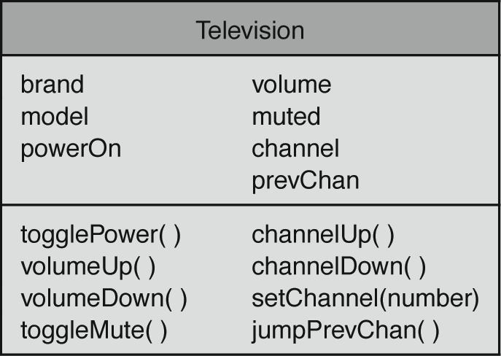
Television Class Diagram
Which are attributes/methods?
p. 16

Slide 47
Instance Methods
Kinds of methods:
  Accessors or inspectors: method that returns the value of an instance attribute such as getChannel()
  Mutators: change value of instance attribute such as setChannel(channel_number)

Slide 48
Instance Methods
Parameter – how information is passed into a method.
Return value – how information is passed out of a method.
The parameters and return value of a method are called its signature.

Slide 49
Identifying Classes and Objects
Sometimes it is challenging to decide whether something should be represented as a class
The more you reuse the code the more the code needs to be in a class.
When a class becomes too complex, it often should be decomposed into multiple smaller classes to distribute the responsibilities
Libraries are groups of classes that can be distributed and reused by different applications

Slide 50
Identifying Classes and Objects
We want to define classes with the proper amount of detail
For example, it may not be necessary to create separate classes for each type of student in a university
It may be sufficient to define a more general Student class with appropriate instance data such as type_of_student, department, etc to describe different types of students
It all depends on the details of the problem being solved

Slide 51
Identifying Classes and Objects
Part of identifying the classes we need is the process of assigning responsibilities to each class
Every activity that a program must accomplish must be represented by one or more methods in one or more classes
We generally use verbs for the names of methods
In early stages it is not necessary to determine every method of every class – begin with primary responsibilities and evolve the design

Slide 52
Identifying Classes and Objects
An object has state and behavior
Consider a university student object
  it’s state can be defined as the student’s name, address, major, and GPA
  it’s primary behavior may be to update the address or to recalculate the GPA
We can represent a student in software by designing a class called Student that models this state and behavior
  the class serves as the blueprint for a student object
We can then instantiate as many student objects as we need for any particular program

Slide 53
University Registration System
What classes do you think such a system would need?

Slide 54
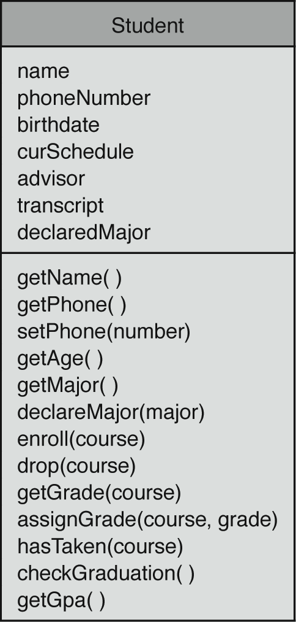
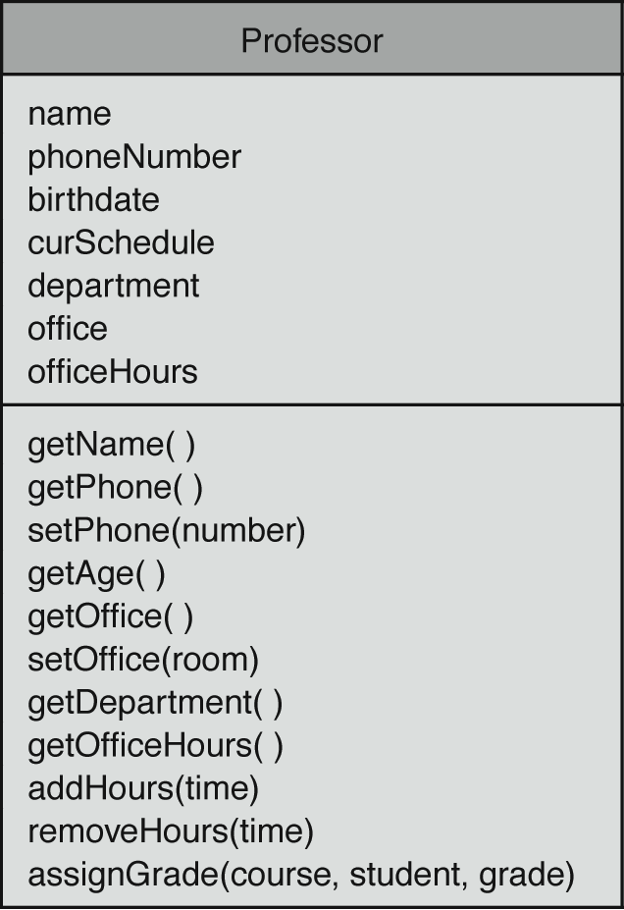
Class Diagrams for Student and Professor p. 20

Slide 55
Student and Professor Inherit from Person
Student and Professor are both persons.
Common attributes:
  name.
  birthdate.
  phone number.
  current Schedule.
Student is-a Person and Professor is-a Person.
Student and Professor inherit from Person.

Slide 56
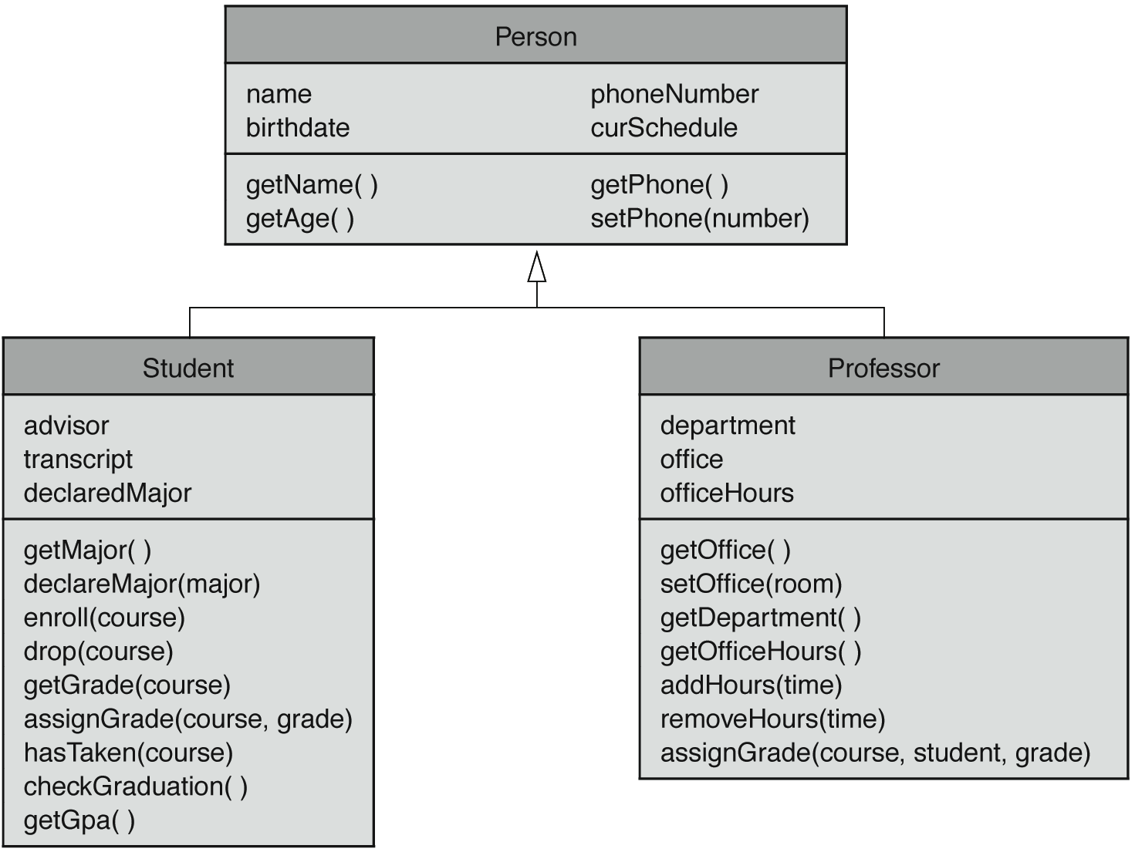
Student and Professor Classes Derived from Person p. 21

Slide 57
UML Diagrams
UML stands for the Unified Modeling Language
UML diagrams show relationships among classes and objects
A UML class diagram consists of one or more classes, each with sections for the class name, attributes (data), and operations (methods)
Lines between classes represent relationshps

Slide 58
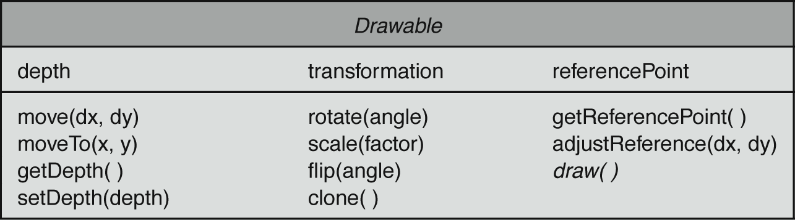
Drawing Package: Class Diagram p.22
Data declarations
Method declarations

Slide 59
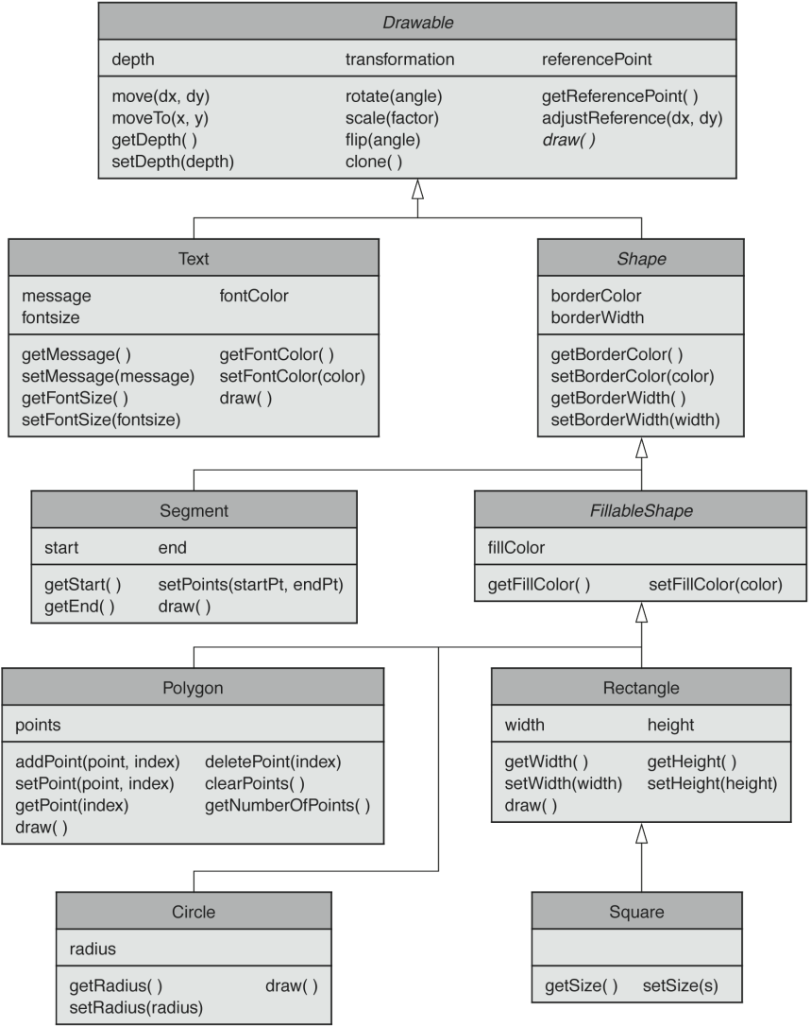
Proposed Hierarchy of Drawable Objects Showing Inheritance. p. 24

Slide 60
The Python Interpreter
A piece of software that executes commands for the Python language
Start the interpreter by typing python at a command prompt
Many developers use an Integrated Development Environment for Python known as IDLE
Object-Oriented Programming in Python
2-<number>

Slide 61
The Python Prompt
>>>
This lets us know that the interpreter awaits our next command
Type in the following
>>> screen = Canvas() #what happened?
Canvas is the class.
screen is the object
screen is user-defined and must only consist of letters, numbers or underscores, cannot begin with number and cannot be a reserved word
Object-Oriented Programming in Python
2-<number>

Slide 62
Our First Example
Now type in the following
>>> from cs1graphics import *
>>> screen = Canvas()
>>>
We see a new Python prompt, so the command has completed.
What did it do?
Object-Oriented Programming in Python
2-<number>

Slide 63
UML Class diagram
for class Canvas
See page 91 for complete class
Canvas
Canvas (w,h,bgColor,title,autoRefresh)
…
…
setTitle(title)
setBackgroundColor(color)
NOTE: the words title and color are NOT placed within the parethesis; the actual title for the canvas and the color for the canvas must be enclosed in single quotes
2-<number>

Slide 64
Our First Example
Now type the following
>>> screen.setBackgroundColor(‘skyblue’)
What happened?
method
object
parameter
Object-Oriented Programming in Python
2-<number>

Slide 65
Our First Example
Type in the following
>>> screen2 = Canvas(200,300)
>>>
We see a new Python prompt, so the command has completed.
But what did it do?
Canvas is the class.
screen2 is the object
Notice some parameters were omitted
Object-Oriented Programming in Python
2-<number>

Slide 66
Our First Example
Type in the following
>>> screen3 = Canvas(200,300,’yellow’,
’My first Canvas’)
>>>
We see a new Python prompt, so the command has completed.
What did it do?
Object-Oriented Programming in Python
2-<number>

Slide 67
Type in the following
>>> mycircle = Circle()
>>> mycircle.setFillColor(‘red’)
>>> screen3.add(mycircle)
Object-Oriented Programming in Python
2-<number>

Slide 68
Week 2 Assignments (see course outline also)
Homework 1, due Monday, Jan. 22
Lab Assignment 2 due Thursday in class, PreLab2 should be read/done

